Slide 1
A Mechanized Model of the Theory of Objects
Ludovic Henrio and Florian Kammüller
Functional ς-calculus in Isabelle
Confluence Proof in Isabelle
Ongoing Work, Applications, Conclusion
Objective
Provide a framework for (mechanically) proving properties on object-oriented languages and programs
➔ Distribution, parallelism, concurrence

Slide 2
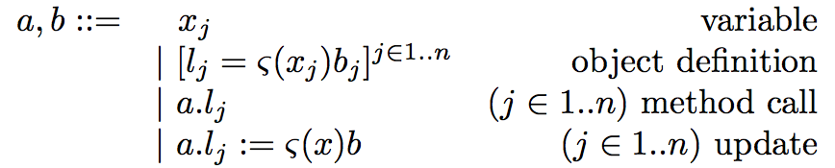
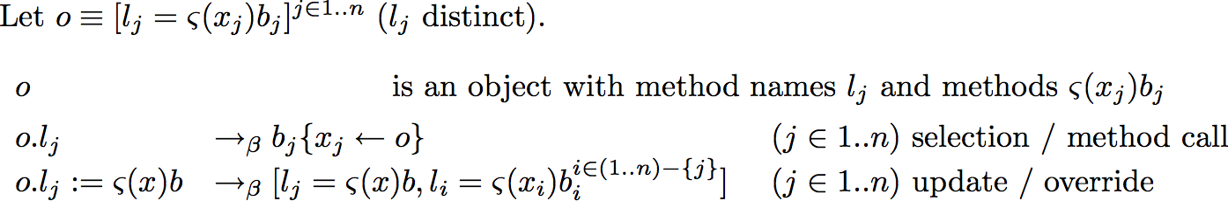
Functional ς-calculus
Syntax
Semantics (Abadi - Cardelli)
Why functional? ➔ updating a field creates a new object (copy)
Each method is a function with a parameter: “self”
1 - Functional ς-calculus in Isabelle

Slide 3


An Example
1 - Functional ς-calculus in Isabelle

Slide 4
An Example
1 - Functional ς-calculus in Isabelle

Slide 5
Isabelle/HOL
Russell’s Theory of Types; Higher Order Logic (HOL)
Meta logic
HOL
1 - Functional ς-calculus in Isabelle

Slide 6
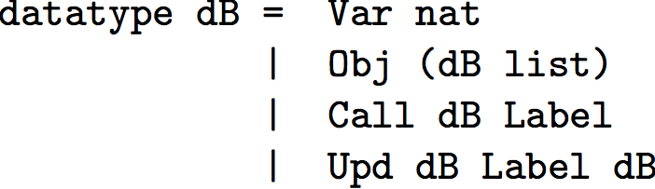
Functional ς-calculus in Isabelle
Syntax
1 - Functional ς-calculus in Isabelle

Slide 7






What are De Bruijn Indices?
De Bruijn indices avoid having to deal with α-conversion
Variables are natural numbers depending on the depth of the parameter
1 - Functional ς-calculus in Isabelle

Slide 8
Why De Bruijn Indices?
Drawbacks:
Terms are “ugly” ➔ We are interested in general properties / not for extracting an interpreter …
Lot of additional definitions/lemmas are necessary:
  Definition of subst and lift: semantics more complex
  Proofs of several additional (easy) lemmas
Advantages
Established approach
Reuse Nipkow’s framework for confluence of the λ-calculus
Alternative approaches, e.g. nominal techniques
➔ probably better on the long term
De Bruijn indices are perhaps not the best solution but allowed a fast implementation
1 - Functional ς-calculus in Isabelle

Slide 9
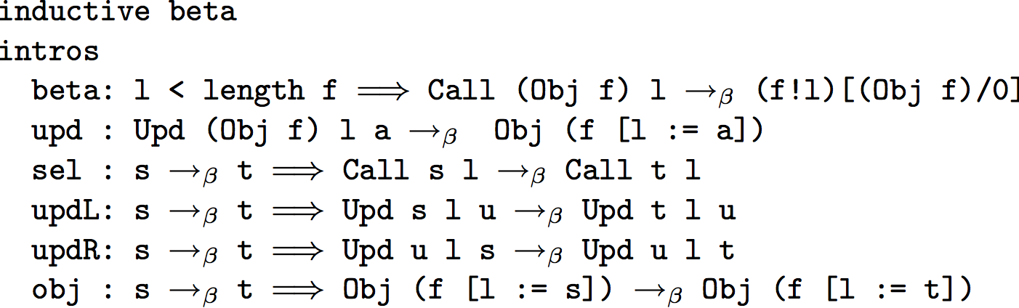
Functional ς-calculus in Isabelle
Syntax
Semantics
substitution
subterm reduction
1 - Functional ς-calculus in Isabelle

Slide 10
2 - Confluence

Slide 11
Confluence Principles
Ensures that all computations are equivalent (same result)
Generally based on a diamond property:
p
q
r
a
Diamond ⇒ confluent:
s
b
c
d
2 - Confluence

Slide 12
Confluence Principles (2)
In general we have to introduce a new reduction that verifies the diamond property
a
b
c
and
⊆
d
⊆
⇒ confluent
2 - Confluence

Slide 13

Confluence of the ς-calculus
Based on Nipkow’s framework: Confluence for the
λ-calculus
  Useful lemmas: commute, Church-Rosser, diamond
  Structure of a confluence proof in Isabelle
Definition of a parallel reduction (verifies diamond)
  Like for λ-calculus, can reduce all sub-terms in parallel
  Also includes (semantics of the ς-calculus)
2 - Confluence

Slide 14
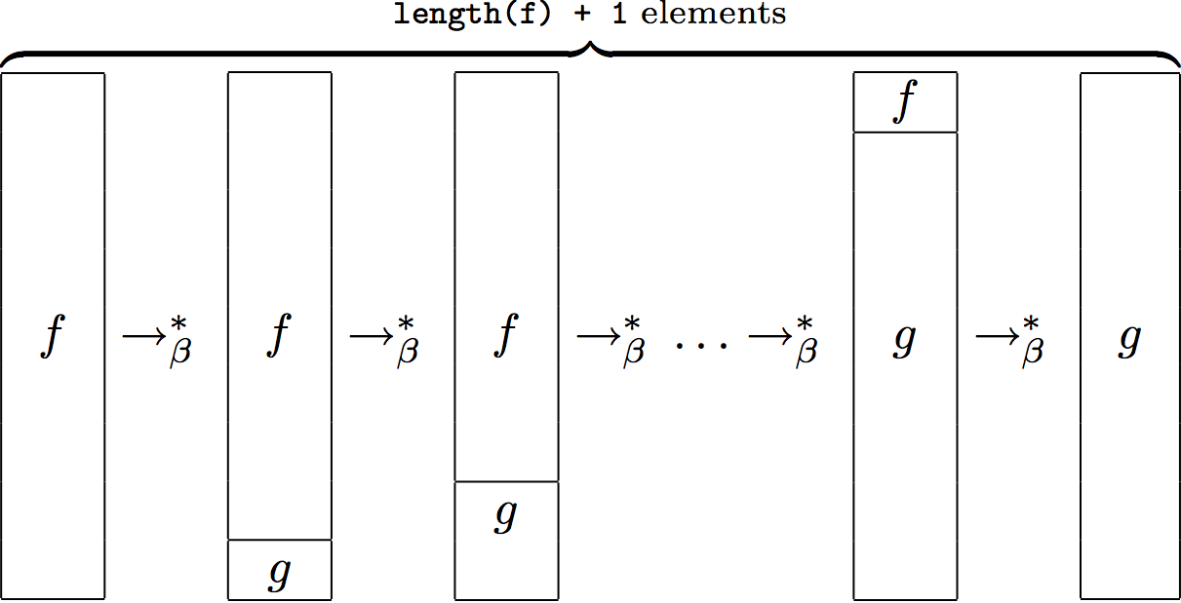
Reducing in Parallel inside Object
Subgoal (looks trivial but proof is tricky):
Solution: split into several reductions on object fields
ς-calculus confluence proof similar to Nipkow’s framework but:
Much less automatic
Difference of granularity between lists of terms and objects
More cases for diamond (more constructors/rules)
Number of
methods
2 - Confluence

Slide 15
In the Meantime …
Objects as finite maps from labels to methods instead of lists of methods
  Definition of finite maps and a new induction principle
  Closer to original ς-calculus (syntax and semantics); new recurrence principle on terms
Formalization of the basic type system for the functional
ς-calculus
  Typing rules (Abadi - Cardelli)
  Subject reduction, progress (no stuck configuration)
3 - Ongoing Work, Applications, Conclusion

Slide 16
Todo List
Remove De Bruijn indices ➔ “nominal techniques”?
Introduce methods with a parameter: ς(x,y) / a.l(b)
Apply to other results on object languages
(concurrence, mobility, …)
➔ A base model for Aspect Oriented Programming
3 - Ongoing Work, Applications, Conclusion

Slide 17
Towards Distribution
A model for the ASP calculus in Isabelle; ASP formalizes:
  Active objects (AO) without shared memory
  AO is the entry point and the master object of the activity
  Communicating by asynchronous method calls with futures
Currently:
  Definition of a functional ASP in Isabelle
  Proof of well-formedness of the reduction (no creation of reference to non-existing active objects or futures)
To do ….
  A type system for ASP
  Proof of confluence for the functional ASP
  Extension of the concurrency in the functional calculus
  Case of the imperative ASP calculus …
3 - Ongoing Work, Applications, Conclusion

Slide 18
Conclusion
A formalization of the ς-calculus in Isabelle
A confluence proof for the functional ς-calculus
  Parallel reduction inside objects
A base framework for developments on objects, confluence and concurrency
A lot of possible applications (distribution / typing / AOP …)
Experiments on Isabelle (few months development)
  User-friendly, relatively fast development
  Finding the right structure/representation is crucial
  Difficulties when modifying / reusing code
http://www.cs.tu-berlin.de/~flokam/isabelle/sigma/
3 - Ongoing Work, Applications, Conclusion

